Slide 1
Best Practices in Software Engineering
Develop Iteratively
Manage Requirements
Use Component Architecture
Model Software Visually
Verify Quality

Slide 2
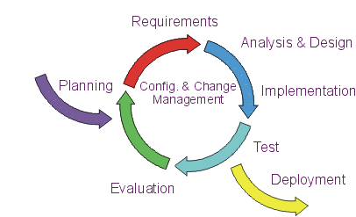
Develop Iteratively
What is iterative Development A project using iterative development has a lifecycle consisting of several iterations.

Slide 3
Develop Iteratively
Critical risks are resolved before making large investments
Initial iterations enable early user feedback
Testing and integration are continuous
Objective milestones provide short term focus

Slide 4
Manage Requirements
Requirements Management is Responsible towards on Project Managers
organizing, and documenting the requirements of the system
maintaining a clear statement of the requirements
User's own understanding of the requirements evolves over time

Slide 5
Cont...
Five Stages of Requirements Management:
1.Investigation
2.Feasibility
3.Design
4.Testing
5.Release

Slide 6
Component-Based Architectures
Permits reuse
Choice of thousands of commercially available components
Improved maintainability and extensibility
Division of work among teams of developers

Slide 7
Visually Model Software
Improve ability to control software complexity
Provide unambiguous communication
Describe the behavior and structure of software components
Able to expose or hide details appropriately for the task

Slide 8
Verify Quality
Purpose of Verification
To assure software system or software component meet the specified requirement.
Quality
The characteristic of producing a product which meets or exceeds agreed upon requirements by some agreed upon objective measures.
Develop test suites for each iteration and test for :
Functionality
Reliability
Performance

Slide 9
THE END

